Slide 1
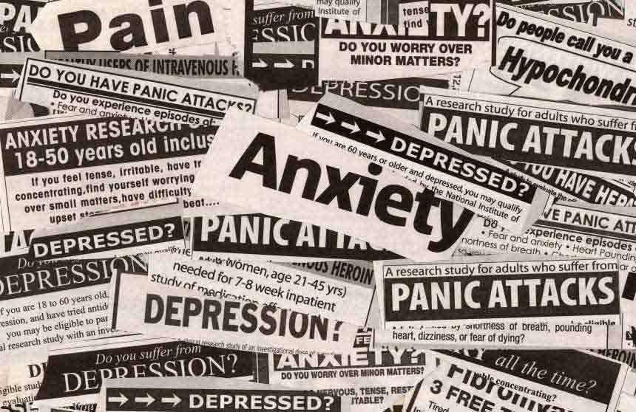
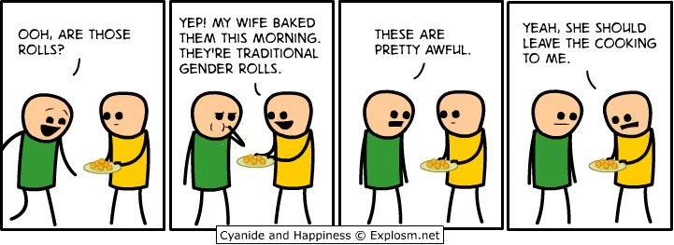
Gender and Emotional Expression: Need for a New Focus?
Lauren Alexandra Ward
Lecturer and PhD Student

Slide 2
Overview
Gender; What it is and why its important
Gender Roles Hypothesis
“Big Boys Don't Cry”...?
Final Thoughts

Slide 3


What do we mean by Gender?(1)
‘...how we are perceived and expected to think and act as women and men because of the way society is organised, and not because of our biological differences’
(WHO, 1998)
Something we ‘have’ Vs. Something we ‘do’

Slide 4
What do we mean by Gender?(2)
‘I'm a man before I'm anything. And that's what people fail to realise about being gay, homosexual, or however you look at it. That they still have the male organ between their legs.’
(Trevor)
‘I mean, I guess in my mind, I'm like anybody should be how they want to be. Like you can act anyway you want.’
(Ron)
Something we ‘have’ Vs. Something we ‘do’
Wilson et al (2010)

Slide 5



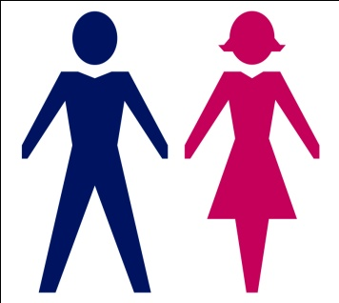
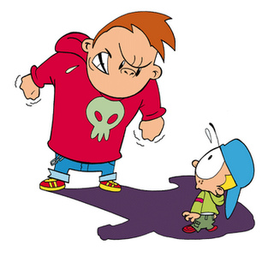
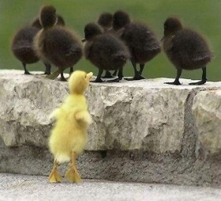
Why Gender?
Notes:
Inter individual factor web
‘There is overwhelming evidence from all fields of health
research that adolescent girls and boys are different with
regards to their biology (sex differences), as well as to
socially and culturally constructed gender norms, roles and
relationships (gender differences). Together gender and
sex, often in interaction with ethnicity and the socioeconomic
circumstances of their community and family, influence
adolescents’ exposure and vulnerability to health risks,
such as depressive disorders, and self-inflicted injures included
suicide. Recognizing the root causes of differences
between adolescent girls and boys in regards to exposure
and vulnerability to health risks, as well as identifying potential
mental health protective factors is therefore crucial
when designing responses from the health and other sectors
in order for these responses to be effective.’ WHO 2011
Thus, there has been more of a focus on contextual factors that contribute to these prevalence/incidence rates.
http://www.guardian.co.uk/society/2010/apr/01/recession-surge-mental-health-problems
Warner, Mxkeown, Griffin, Johnson, Ramsay, Cort and King (2004)- gay, lesbian and bisexual population more likely to experience mental ill health, possibly due to discrimination and school bullying.
The differential vulnerability hypothesis- women react differentially to material and social aspects that fosters positive mental health (and are further marganisalised by gender expectations) and thus are more vulnerable to mental ill health.
Whereas the differential exposure hypothesis argues that women report higher mental health issues because they do not have access to the resources to foster positive mental health.
In a study on predictors of mental ill health in turkish women, it was found that the majority of the women (60.3%) experienced physical
(30.0%), verbal (29.1%) or economic (27.9%) domestic violence in their life in this study (Simsek, Ad, Altindag, Gu, and Zeynep 2008) . Intimate partners (95.9%) are
most commonly the perpetrators of violence against women as consistent with this study. Violence against women is a
public health problem in the world that has received increased attention from researchers and health care providers (Blazer et al, 1994; Krug et al, 2002). In the WHO (2005) on women and domestic violence, the proportion of women who had ever suffered physical violence by a male partner ranged
from 13% in Japan to 61% in provincial Peru. Around the world, mental health problems and emotional distress are common among women who have suffered partner violence. Although poor mental health can be a risk factor
for violence (Burnam et al, 1988) mental disorders can result from assault
Experiences (coker et al, 2003) Good mental health may be a protective factor against revictimization (Jones et al, 2006).
http://www.bps.org.uk/news/childhood-trauma-and-adult-mental-health- childhood trauma
http://apt.rcpsych.org/content/10/3/216.full- poverty:
‘Moreover, people in lower socio-economic classes by virtue of their life circumstances are exposed to more stressors, and with fewer resources to manage them and greater vulnerability to stressors, they are doubly victimised. Poverty is associated with many long-term problems, such as poor health and increased mortality, school failure, crime and substance misuse. it is generally conceded that poverty can be both a determinant and a consequence of poor mental health ‘(Langner & Michael, 1963).
‘In the 1995 survey published by the Office of Population Censuses and Surveys (Meltzer et al, 1995) employment status was a major factor in explaining the differences in prevalence rates of all psychiatric disorders in adults. Unemployment significantly increased the odds ratio of psychiatric disorders compared with the reference group. It almost quadrupled the odds of drug dependence after controlling for other socio-demographic variables. Unemployment also approximately trebled the odds of phobia and functional psychosis. It more than doubled the odds of depressive episode, generalised anxiety disorder and obsessive–compulsive disorder, and increased the odds of mixed anxiety and depressive disorder by more than two-thirds’
‘According to the social causation theory, the greater socio-economic adversity characteristic of lower-class living conditions precipitates psychosis in vulnerable individuals.’
http://bjp.rcpsych.org/content/184/5/416.full – sexual abuse.
Conducted a prospective study, and found that childhood sexual abuse a good predictor of adult mental ill health. Although sample predominantly made up of females, and research largely looks at females.
http://compeer.org/Portals/58/documents/BU%20StudyPublished2008.pdf- social support as a ‘buffer’ (Brian et al, 2007)
Wetzel (2000) women are greater at risk of being more adversly affected by poverty due to being ‘routinely disadvantaged by gender inequalities’ (Tummey and Turner, 2008, p. 97) than their male counterparts. WHO (2001) women in general experience greater deprviation, less social and political power and less access to education, employment and health than men. Lone mothers and older women are particiularly vulnerable (Doyal, 2000), and the care of sick/disabled largerly falls on women of which has several MH implications (Singeltone et al, 2002).
Studies in the UK and USA reveal at least half of those women who are within MH services also dealt with childhood sexual or physical abuse (Itzen, 2006; McCauley et al, 1997; Mullen et al, 1993).
WHO done a larger amount of research internationally on the effects of sexual and domestic abuse on women, found to increase rates of depression, anxiety, PTSD, substance misuse etc...
Given that the WHO (2013) found that 25% of the worldwide population will be affected by a mental health issue, of which is positioned as a ‘global burden of disease worldwide’ (14%).

Slide 6
Gender : Statistical prevalence
Gender: A ‘critical issue’?
Women | Men
Depressive symptoms
and anxiety are twice as common among girls as boys (Ge et al., 1994; Hankin et al., 1998). By 2020 predicted to be a major ‘disease burden’ for women (Schmitt, and Kirch, 2006)
Higher rates of substance abuse among boys (Seedat et al., 2009); 80% of those reported to be alcohol dependant in adulthood are male (The Office for National Statistics Psychatric Mordbity report, 2001)
Almost ¾ of people dependent on cannabis and other illegal drugs are male(The Office for National Statistics Psychiatric Morbidity report, 2001).
60% of those with Phobias or OCD are female
‘Girls are more than two and a half times as likely as boys to have an eating disorder’. (Merinkangas, et al 2010)
Men are three times more likely to take their own lives through suicide (NIMHE, 2008; ONS, 2013)
Internalising syndromes
Externalising syndromes
Notes:
!!Note: Less is known on gender differences and MH in developing countries (Tummey and Turner, 2008) !!
See: http://www.mentalhealth.org.uk/help-information/mental-health-statistics/men-women
Existing research shows a distinct gender pattern in mental
health after the age of 13 years; different problems afflict
boys and girls, and girls generally report more mental
health problems than boys (Myrin and Lagerstrom, 2008).
Schmitt NM, Kirch W. Council of the European Union: conclusions
on women’s health—a report. J Public Health 2006;14:6.
Could be argued suggestions differences in expression, as opposed to prevelance of MHI. More so, that there are ‘gendered patterns of mental distress’ (Tummey and Turner, 2008, p.96).

Slide 7
Gender Role Hypothesis
Crying
Strong
‘not crying at a movie’
Caring and nurturing
Rational
Lack of control over emotions
In control
‘Breadwinner’
Confident
heterosexual
“Dont just clean it woman, scrub it....Think of your body as the kitchen floor”

Slide 8
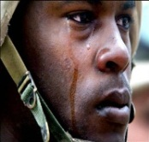
“Big Boys Don't Cry”: Gender and the Military
Military culture regarded as a hyper masculinised and hierchal subculture, with its members characterised by psychological vulnerability and unwillingness to seek support for psychological distress (Higate, 2005)
Green et al (2010), looked at ex-servicemen 16-26yrs upon joining; found ‘service environment engendered a ‘stiff upper lip’ response to stress’ (p. 1484).
BUT, is it a case of ‘no emotion’ in the military?

Slide 9

“Big Boys Don't Cry”: Gender and the Military
P: ‘If you’re a little bit upset because you’re missing your family you tend to keep that to yourself because that’s perceived as weak or, y’no, ‘stop being a girl’ sort of thing, or ‘missing your wife arh your with the lads come on’. I suppose of something stressful happened on operation like your involved in when somebody got hurt, injured or killed or whatever then erh, then I suppose yeah they do look after you quite well.’
Messages about acceptable (masculine) and unacceptable (feminine) forms of emotional expression
R: ‘it’s not in a man to get upset like a woman anyway’

Slide 10
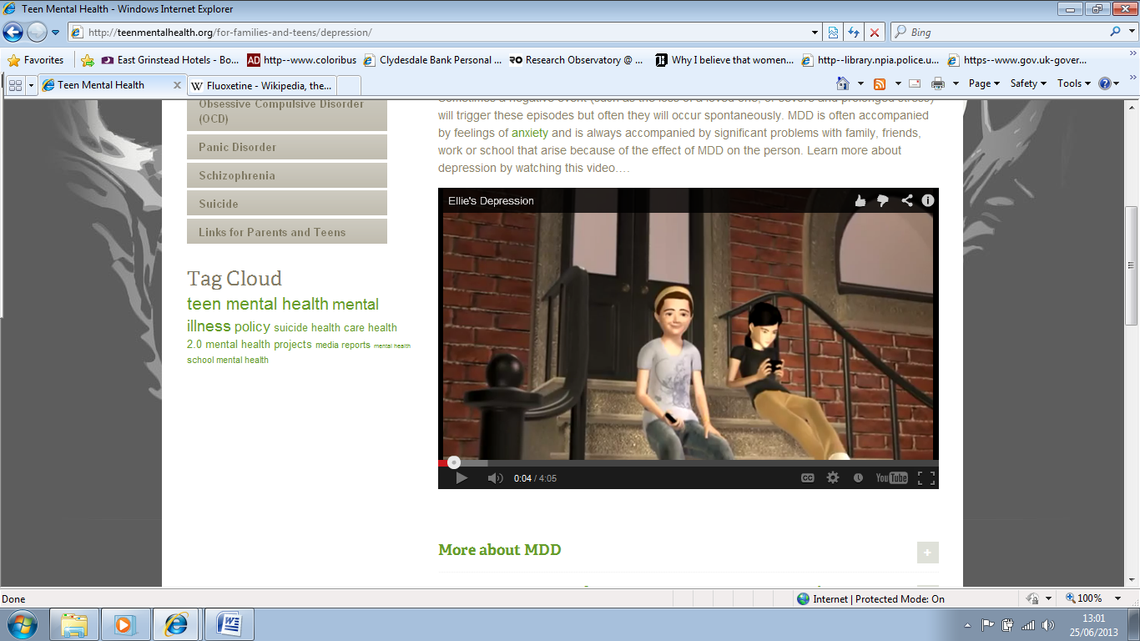
Gender Role Hypothesis
‘Teen Mental Health’
The Mental Health Foundation
‘Women are more likely to be treated for a mental health problem than men’ (Mental Health Foundation, 2013)
‘Ellies Depression’
The National Institute of Mental Health
‘About 11 percent of adolescents have a depressive disorder by age 18...Girls are more likely than boys to experience depression.’
Notes:
Implicitly homogenising?

Slide 11
Gender Role Hypothesis
Depressed
Other

Slide 12
Gender Role Hypothesis
Other (or ADHD)
2X ADHD

Slide 13


Final thoughts:
Drug dependant
Alcohol Dependant
Suicidal?
Anxiety
Depression
Eating Disorders
Vulnerable?
Suicidal?
Considerations, not expectations
Avoid implicitly homogenising and categorising
Notes:
ADDD A VARIETY OF CONTEXTUAL FACTORS SUGGESTED TO IMPACT AND MODERATE MENTAL HEALTH?

Slide 14


Thank You For Listening!
Lauren.ward@northampton.ac.uk
Twitter: Lauren8Ward

Slide 15
References:
Kolbo, J.R., Blakeley, E.H., and Engelman, D. (1996) "Children who witness domestic violence: A review of the empirical literature" Journal of Interpersonal Violence Vol.11, No.2, p.281; Morley, R. and Mullender, A. (1994) "Domestic violence and children: what we know from research" in Mullender, A. and Morley, R. Children living with domestic violence; Putting men's abuse of women on the childcare agenda (London: Whiting and Birch Ltd.); Hester, M., Pearson, C., and Harwin, N. (2000) Making an impact: Children and domestic violence: A reader (London: Jessica Kingsley).
Leadbeater, B.J., Kuperminc, G.P., Blatt, S.J., Hertzog, C. (1999). A multivariate model of gender differences in adolescents internalising and externalising problems, Developmental Ppsychology, 35, (5), pp, 1268-1282.
Statistics eating disorder
http://www.nimh.nih.gov/statistics/1eat_child.shtml
Suicide gender rock
http://www.guardian.co.uk/commentisfree/2013/jan/23/suicide-rates-men-gender-issue
Domestic violence
http://www.womensaid.org.uk/domestic-violence-articles.asp?section=00010001002200040001&itemid=940
Riots
http://www.guardian.co.uk/uk/2011/dec/05/who-were-the-rioters

