Slide 1
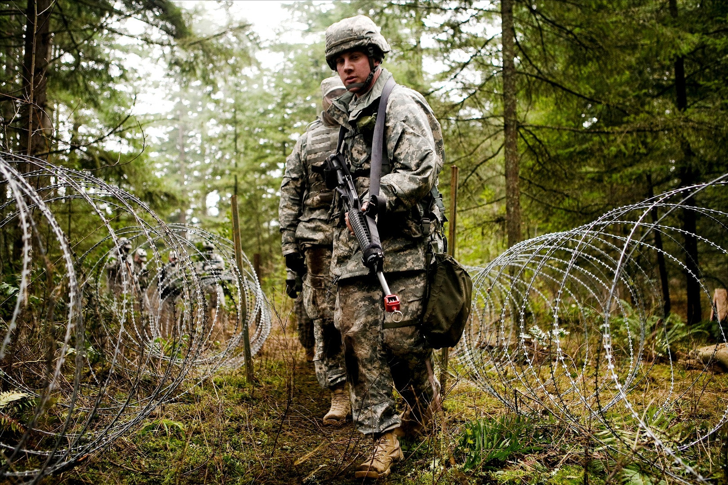
Military ‘Manliness’: The Construction of Masculinity and Emotional Expression within Ministry of Defence Advertising Campaigns
Lauren Ward and Jane Callaghan
University of Northampton

Slide 2
Aims and Background:
Previous paper:
The construct of military masculinities moderate how emotion(s) are understood and managed
Current paper:
Preliminary analysis
Still image recruitment campaigns for The Royal Marines, Royal Air Force and The British Army.
Explore how these messages of being ‘real’ man/recruit are constructed
Consider possible implications these messages have for understandings of emotion

Slide 3
Previous Research(1):
Dominant discourses of masculinity within the military endorse characteristics such as competitiveness (Higate, 2005), stoicism (Kovitz, 2003), and physical and mental strength (Higate, 2003). These attributes provide the basis of a ‘military masculine identity’ (Ward and Callaghan, 2012).
Ward and Callaghan (2012):
Emotional expression and the ability to feel are represented as feminised, e.g.
‘it’s not in a man to get upset like a woman anyway’
(Ron).
Emotions and femininity positioned as a hindrance and potentially life threatening:
‘Women will cry at the silliest things. But you can’t afford that in the military environment, you can’t risk that. Just the way women are, they like cuddly things that are pink and fluffy. Whereas the big boys don’t cry.’
(Patt)

Slide 4
Previous Research(2):
However, contradictions in previous research on how emotions are understood/managed:
‘the whole culture of the military is that you don’t talk about feelings or emotions’
(Marshall, 2006, p.32).
Vs.
‘Emotion is not entirely ‘unmasculine’, rather emotional expression is dichotomised as either ‘appropriately masculine’, or ‘inappropriately feminine’
(Ward and Callaghan, 2012)

Slide 5
Method:
6 images for recruitment campaigns:
4 Royal Marines- presented today
1 Royal Air Force
1 Territorial Army
Found via Google with keywords
Analysed using Discourse Analysis
Focus on MODs interpellation of potential recruits;
‘Creators of the advertising industry realized representing and selling products also means representing and selling identities.’
(Pajnik and Lesjak-Tuse, 2002, p.281)
Notes:
Detail on how found pictures; top ten, other sampling strategy? Interpellation is a process by which we organize ourselves into the position offered by advertising discourse in the presentation of a particular product.

Slide 6
Background: The Royal Marines(1)
Background:
Considered internally as the ‘elite’ organisation:
‘well first and foremost the commandos they are elite infantry, erm. They are recognised as defiantly erm the best in this country along with the para’s in the army and definitely one of the best units in the world. ‘
(Mark)
Women are excluded from service, several ‘explanations’ have been cited to justify this exclusion:

Slide 7
Background: The Royal Marines(2)
Background(1):
Issue with creating and solidifying recruit bonds:
‘the continued exclusion of women from ground close-combat roles was a proportionate means of maintaining the combat effectiveness of the Armed Forces and was not based on a stereotypical view of women’s abilities but on the potential risks associated with maintaining cohesion in small mixed-gender tactical teams engaged in highly-dangerous close-combat operations.’
(MOD, 2010)
2. Women (and associated characteristics) put other recruits at risk
“The UK looked at this same issue some years ago and decided this was not a good idea, in 2002 and 2008. Thirty years of studies, reports and actual experience have shown that in direct ground combat units, the infantry, women do not have an equal opportunity to survive or to help fellow soldiers to survive. The physical aspects of it are only part of the reason.”
(The Express, 2013)
Notes:
ACCORDING to at least one military expert, this is a watershed moment. Following a decision by the US Defence Secretary Leon Panetta, women are to be allowed to assume combat roles in the American army, overturning a 1994 ban. It means that hundreds of thousands of frontline positions and elite commando jobs could be opened up to them. And the question is: will the British armed forces follow the US lead? Significantly, America’s move has already provoked a mixed response.
One who has spoken out against the decision is Elaine Donnelly from the US Center for Military Readiness, who called the move “unfortunate” and cited British reviews into the matter.
The MoD says that the last time the issue was reviewed was in 2010 when it concluded there would be no change to the existing policy, which is to bar women from close-combat roles on the ground. It insists there are “no plans for a further immediate review”. As it stands around nine per cent of the British armed forces are women. In the Army, 67 per cent of all jobs are open to females, compared with 96 per cent in the RAF and 71 per cent in the Royal Navy. But opportunities are continuing to open up. In 2011 women were allowed to serve on submarines for the first time and have been heavily involved in the wars in Iraq and Afghanistan, serving as pilots, military police and intelligence officers.

Slide 8
Background: The Royal Marines(3)
Background(2):
‘the nature of the activities in question and the context in which they are carried out... such exclusion...were proportionate, appropriate and necessary for the purpose of guaranteeing public security.’
(MoD, 2010)
3. Women as inferior, burdensome and (of course), ‘hormonal’
“I think teh [the] record of women doing anything in combat situations apart from nursing behind the lines is questionable. As to them walking into combat zones carrying 60lbs of kit, I think we all know the answer to that one. Unless they are Fatima Whitbread lookalijkes [lookalikes], they will be sharing their weight around on all the unfortunate male team members. Not sure I'd give a weapon to a hormonal woman either...”
(Thread comment from The Standard, 2013)
Advertising campaigns largely centre on the ‘It’s a State of Mind’ Slogan
Notes:
ACCORDING to at least one military expert, this is a watershed moment. Following a decision by the US Defence Secretary Leon Panetta, women are to be allowed to assume combat roles in the American army, overturning a 1994 ban. It means that hundreds of thousands of frontline positions and elite commando jobs could be opened up to them. And the question is: will the British armed forces follow the US lead? Significantly, America’s move has already provoked a mixed response.
One who has spoken out against the decision is Elaine Donnelly from the US Center for Military Readiness, who called the move “unfortunate” and cited British reviews into the matter.
The MoD says that the last time the issue was reviewed was in 2010 when it concluded there would be no change to the existing policy, which is to bar women from close-combat roles on the ground. It insists there are “no plans for a further immediate review”. As it stands around nine per cent of the British armed forces are women. In the Army, 67 per cent of all jobs are open to females, compared with 96 per cent in the RAF and 71 per cent in the Royal Navy. But opportunities are continuing to open up. In 2011 women were allowed to serve on submarines for the first time and have been heavily involved in the wars in Iraq and Afghanistan, serving as pilots, military police and intelligence officers.

Slide 9
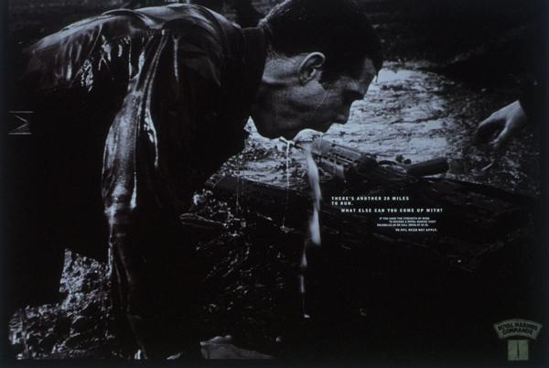
Analysis: The Royal Marines(1)
‘Its a State of mind’
“Ads are loaded with images of ways to be”
(Williamson 1978, 13).
Advertising mark, identity of a ‘good’ Marine:
Competitive
Overcoming perceived barriers
Have initiative
Obedient
Functions to ‘sell’ images about being a ‘real’ masculine male, with a ‘real’ masculine career, and pose as a challenge to be accepted (to those deemed special enough)
‘There's another 30 miles to run. What else can you come up with?’
Notes:
Built into all four images are these suggested attributes o

Slide 10
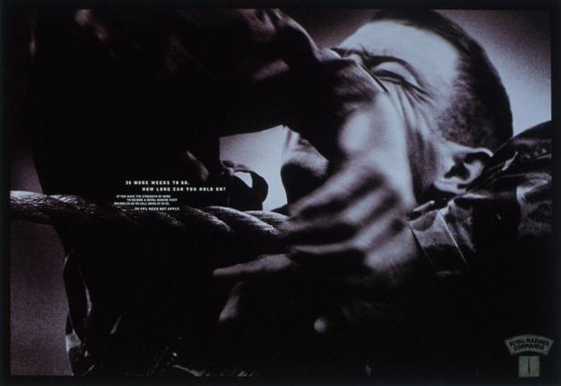
Analysis: The Royal Marines(2)
‘Inner voice’ presents several questions to the reader;
Being a marine is an achievement; can YOU hold on?
Are YOU good enough to hold on?
Do YOU want to find out?
Interpellates reader as a subject; telling you what you want
‘Its a State of mind’
‘Ten more weeks to go. How long can you hold on?’
Notes:
‘well you do see it all the time, in training you just get pushed, someone gets pushed too far, too much, and they break. You just snap...
Or they go right fuck you, excuse my language, I’m gonna, you think you can break me I’m not gonna break and you just carry on. You just get up. ‘ Marine, Marine (notion of emotion being an obstacle to overcome)

Slide 11
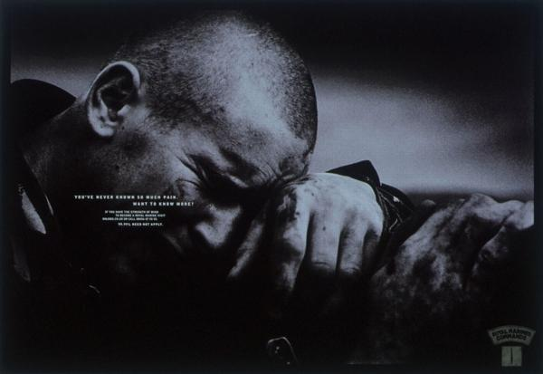
Analysis: The Royal Marines(3)
‘Its a State of mind’
M: ‘I mean anyone else would have keeled over but I ran (Takes a deep outward breath and pauses for a moment), nearly sixty miles in 72 hours with blood poisoning which, I mean septicaemia is dangerous it would fuckin’ kill ya. … ‘ And I ran nearly sixty miles with it. That’s, that’s not, and well yeah I was fit, but that was all in the head, that was me mentally going nah there’s nothing wrong with you but your fucked. So that’s the kind of erm, the mental determination that we have.’
You’ve never known so much pain.
Want to know more?
Notes:
A lack of=femininity
derogatory comments from instructors: “girls can do better” or “you bunch of girls are always at the back” (Hockey, 1986, in Higate, 2003, p.17).

Slide 12
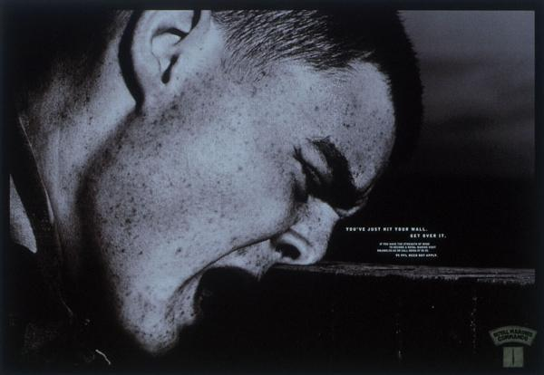
Analysis: The Royal Marines(3)
‘Its a State of Mind’
Emotions as:
concrete, visible, SEEN
As a barrier
A challenge; ‘get over it.’
...and if you cant?
P: ‘If you’re at work doing what your meant to be doing and you stop to have a cry your seen as letting the side down, so you create a weakness in that group that is not necessarily necessary.’
REAL men do not show feminine emotions (Connell, 2005).
Emotions= challenge to overcome, used to prove commitment
‘You have just hit your wall. Get over it.’

Slide 13
Discussion
Concretisation of emotion; feeling as something that is concrete, ‘etched’ on someone's face.
Being a ‘Good’ and ‘Proper’ Marine; Selling an identity, a lifestyle (e.g. ‘Its a State of Mind’).
Implications for understanding emotion?
Emotion as a barrier to overcome; there are no ‘limits’ for the ‘good’ marine.
A degree of masculine emotional expression as showing commitment to the ideology. Too much? Burdensome and thus feminine.
‘well you do see it all the time, in training you just get pushed, someone gets pushed too far, too much, and they break. You just snap...
Or they go right fuck you, excuse my language, I’m gonna, you think you can break me I’m not gonna break and you just carry on. You just get up.’

Slide 14
Final Thoughts
‘The stiff upper lip was arguably indispensable in the 20th century. Talking about our emotions may not have helped in times of world war and widespread carnage. But the world has changed. The stiff upper lip is a deformity and its causing so much damage’
(BBC, 2013)
M: ‘...and I tell you what, climbing a rope with 30 pounds of weight is a fucking man test....’
Good
Vs.
Bad
(and proving it)
Messages about being a ‘good’ masculine recruit,
presents emotion as a barrier to overcome
Emotion Vs. Reason
‘personally I can see why it’s stigmatised I think if it wasn’t lots of young lads would be crying their eyes out... It seems to me if you tell someone they are strong they are, if you say (in a small voice) “oh you alright mate do you wanna cry?” then they will.’
(Patt)
“girls can do better” or “you bunch of girls are always at the back”
(Hockey, 1986, in Higate, 2003, p.17).
Notes:
Clearly embedded within these advertisements are these messages about being a good and proper recruit, whilst implciitly warning about not measuring up. If you are not good enough, you are feminine. Emotions are something that are tactifully used- being emotional because of physical pain shows commitment, but prolonged emotion, for an unmasculine reason, positions you as not worthy, not good enough, and essentially femoinine. Thus there is this idea that emotion interferes with reason, being emotional is not consistent with being this masculine male, this idea that this ideal is used to prevent being emotional, because it hinders operational effectiveness.
This quote by a father who wrote an article titled ‘Loosing a son to suicide’ for the BBC in June 2013, he discussed the need to ‘act’ and educate to help young men discuss their distress,. Clearly here he is discusses this masculinised view to coping and making sense of emotion. He highlights this ‘stiff upper lip’ mentality as something that has outlived its uses; that once was useful but is now considered deformity. Thus emotions here are presented as something that was initially dispensable if not damaging, whereas now this ‘stiff upper lip’ is seen as creating a blockage, and not allowing the expression of emotions is creating this floodgate, which is damaging. Thus this presents gender as a filter to which emotions are understood and managed.
Appropriatley masculine- emotion as purposeful, a barrier to overcome; useful if showing physical pain, shows commitment to the ideal. But if this emotion interfers with your duties, your ability to compete and achieve this military masculine identity- inappropriately feminine.

Slide 15
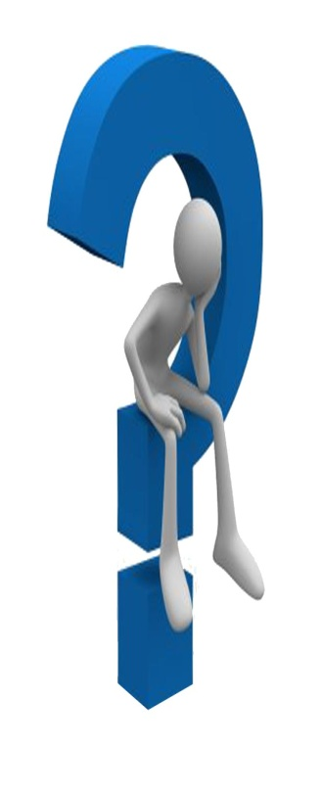
Thank you for listening!
Lauren.ward@northampton.ac.uk
Follow me: Lauren8ward
Feedback is appreciated (notepad at the ready...)
Notes:
This quote by a father who wrote an article titled ‘Loosing a son to suicide’ for the BBC in June 2013, he discussed the need to ‘act’ and educate to help young men discuss their distress,. Clearly here he is discusses this masculinised view to coping and making sense of emotion. He highlights this ‘stiff upper lip’ mentality as something that has outlived its uses; that once was useful but is now considered deformity. Thus emotions here are presented as something that was initially dispensable if not damaging, whereas now this ‘stiff upper lip’ is seen as creating a blockage, and not allowing the expression of emotions is creating this floodgate, which is damaging. Thus this presents gender as a filter to which emotions are understood and managed.

Slide 16
https://www.gov.uk/government/uploads/system/uploads/attachment_data/file/27403/Report_review_excl_woman_combat_pr.pdf
http://www.express.co.uk/news/uk/373000/Should-Britain-ever-put-women-on-war-s-frontline

